Slide 1
WEB APPLICATION DEVELOPMENT TRAINING
HTML Table, HTML Form – Day 4

Slide 2
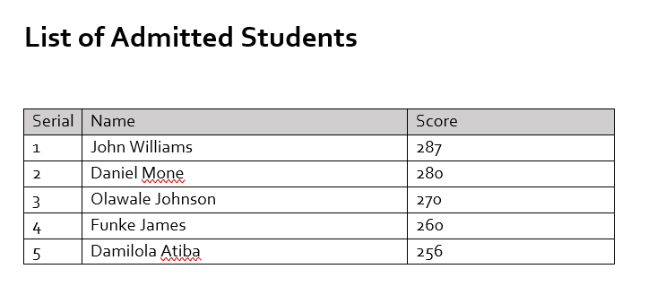
HTML Tables
Sometimes in your web application, you need to create a table which holds data just as you have it in word processing documents:
A table is a structured set of data made up of rows and columns (tabular data).
A table allows you to quickly and easily look up values that indicate some kind of connection between different types of data.

Slide 3
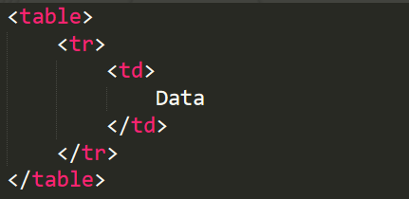
It is a combination of nested tags
An HTML table is defined with the <table> tag.
Each table row is defined with the <tr> tag.
A table header is defined with the <th> tag. By default, table headings are bold and centered.
A table data/cell is defined with the <td> tag.
The <td> elements are the data containers of the table.
Contents can not be in the <tr> or <table> tag directly!

Slide 4
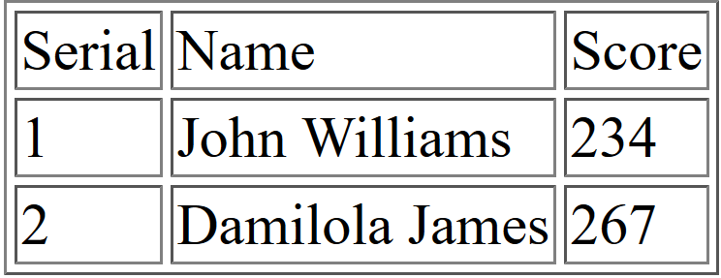
QUIZ: Create a table that looks like this
Hint : The border attribute

Slide 5
Attributes of HTML Table
What do you observe with the width? Any control over this? *
The width attribute, dimensions can be in px or %
Table Properties – border, cellspace, cellpadding, align (alignment per td), height, bgcolor
Cellspacing and Cellpadding: attribute of the table (not td)
EXERCISE: Apply any of the above properties on the table you just created
an optional <thead> element, <tbody> and <tfoot> (the benefit of this is seen in the css module)
Notes:
The width grows with contents, the growth of a td affects the tds below it and above making them have the same td hence the rigidity of table

Slide 6
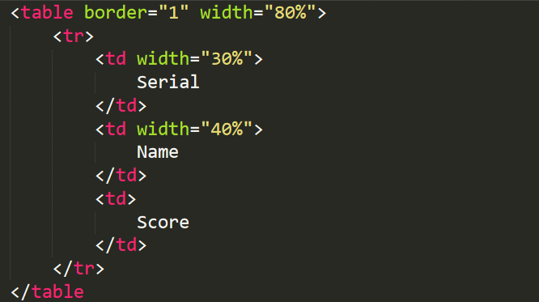
Attributes of HTML Table
A table’s dimension has been specified in % as shown below:
QUIZ: What will be the width of the ‘score’ column ?
Notes:
It will be 100- (30 + 40) = 30% NOT 10%

Slide 7
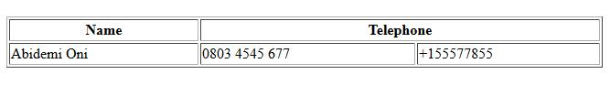
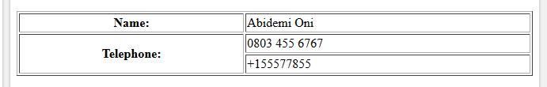
Spanning table rows, (rowpan) Spanning table columns (colspan)
Understanding colspan
Understanding rowspan

Slide 8
HTML Table Layout - Colspan
<table border='1'>
<tr>
<th>Name</th>
<th colspan="2">Telephone</th>
</tr>
<tr>
<td>Abidemi Oni</td>
<td>0803 4545 677</td>
<td>+155577855</td>
</tr>
</table>

Slide 9
HTML Table Layout - rowspan
<table border='1' width='100%'>
<tr>
<th>Name:</th>
<td>Abidemi Oni</td>
</tr>
<tr>
<th rowspan="2">Telephone:</th>
<td>0803 455 6767</td>
</tr>
<tr>
<td>+155577855</td>
</tr>
</table>

Slide 10
Practice
Try out colspan and rowspan

Slide 11
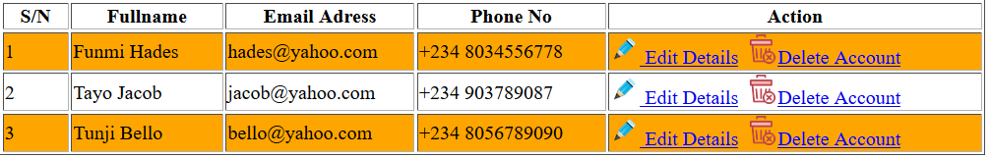
Attributes of HTML Table
A table just as it contains the lists of names can contain all sorts of HTML elements; text, images, links or even other tables.
Tables can also be nested, a table <td> can even contain another table.
Exercise: Using HTML table, design something similar to the above.
Valign to move contents to the top, middle or bottom of the cell
Notes:
The exercise also tests if participant can resize image to make it fit as an icon

Slide 12
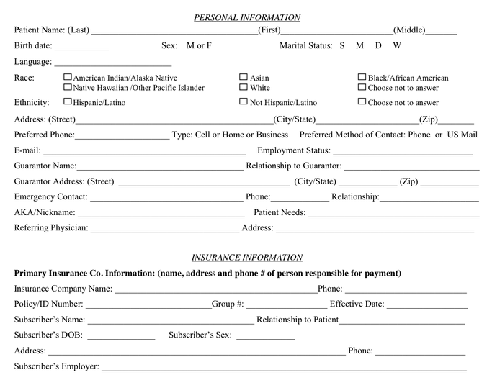
HTML Form
The form is used in capturing data from the users
It facilitates dynamic contents on your website
When automating any manual process, converting paper forms to their web equivalence is one of the important tasks you need to do.
Data captured are sent to a page specified.
The submit button is used in sending the data to the specified page

Slide 13
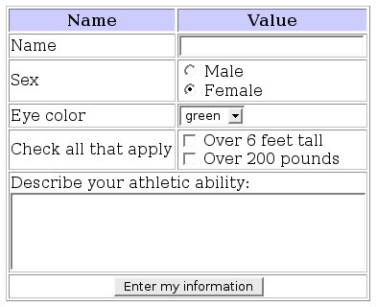
The <form> Element
The <form> Element
The HTML <form> element defines a form that is used to collect user input:
<form> . form elements . </form>
The form tag has 2 important attributes namely: action and method which specifies the destination page and the means of transporting the data to the destination

Slide 14
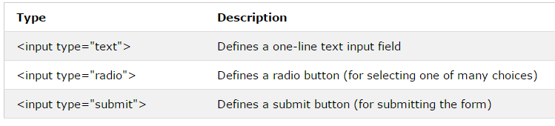
The <form> Element
An HTML form contains form elements.
Form elements are different types of input elements in different shapes and for capturing varying sets of data,
Examples are text fields, checkboxes, radio buttons, submit buttons, and more.
The <input> Element
The <input> element is the most important form element.
The <input> element can be displayed in several ways, depending on the type attribute.
Here are some examples:

Slide 15
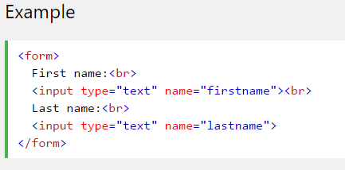
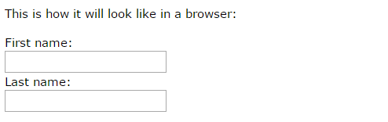
The <form> Element
Text Input
<input type="text"> defines a one-line input field for text input:
Some attributes of the input text field are: size and maxlength which determines the width and the number of characters it can take respectively

Slide 16
The <form> Element
The label tag
Pressing a label basically triggers the focus event for the bound input. Interesting thing is that, if it is a file input, it works out as a click event, resulting in opening a file browser.
<label for="email">Email</label>
<input type="text" name="email" id='email’>
Since the id is the same as the content of for=‘’ as shown above , clicking on the label will place the cursor within the email text field
Try it out

Slide 17
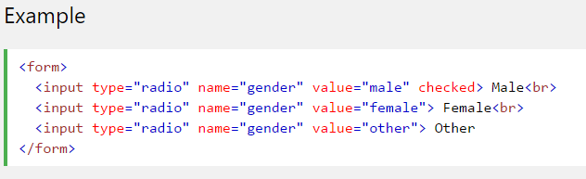
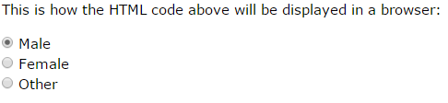
The <form> Element
Radio Button Input
<input type="radio"> defines a radio button.
Radio buttons let a user select ONE of a limited number of choices:

Slide 18
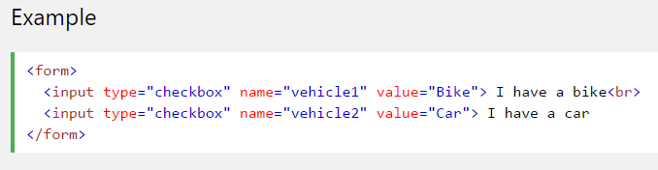
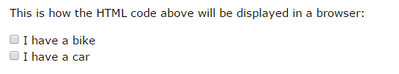
The <form> Element
Input Type Checkbox
<input type="checkbox"> defines a checkbox.
Checkboxes let a user select ZERO or MORE options of a limited number of choices.

Slide 19

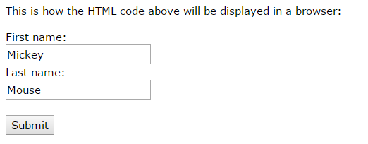
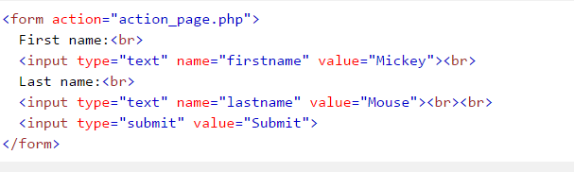
The <form> Element
Input Type Button
<input type="button"> defines a button: Javascripts can be further applied to input of type button to make it perform some interactive functions (this will be covered in subsequent modules)
The Submit Button
<input type="submit"> defines a button for submitting the form data to a form-handler.
The form-handler is typically a server page with a script for processing input data.
The form-handler is specified in the form's action attribute:

Slide 20
Text area
The <textarea> tag defines a multi-line text input control.
The <textarea> element is often used in a form, to collect user inputs like comments or reviews.
The size of a text area is specified by the <cols> and <rows> attributes

Slide 21
HTML Form – The button tag
HTML 5 Supports the <button> tag, <button> Submit </button>
It has an attribute type which tells the type of button it is: button, submit and reset
If the type attribute is not specified, the default is submit

Slide 22
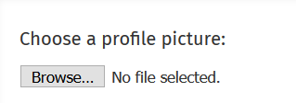
Input type file
<input> elements with type="file" lets the user choose one or more files from their device storage. Once chosen, the files can be uploaded to a server using some file manipulations (server side or client side)
The tag can optionally have a boolean attribute, 'multiple' to allow the user enter more than one value in the <input> element

Slide 23

The <form> Element
The Action Attribute
The action attribute defines the action to be performed when the form is submitted.
Normally, the form data is sent to a web page on the server when the user clicks
on the submit button. In the example above, the form data is sent to a page on the server
called "action_page.php". This page contains a server-side script that
handles the form data:
If the action attribute is omitted, the action is set to the current page.

Slide 24


The <form> Element
The Method Attribute
The method attribute specifies the HTTP method (GET or POST) to be
used when submitting the form data:
or

Slide 25

The <form> Element
When to Use GET?
The default method when submitting form data is GET.
However, when GET is used, the submitted form data will be visible in the page address field:
When to Use POST?
Always use POST if the form data contains sensitive or personal information. The POST
method does not display the submitted form data in the page address field.
POST has no size limitations, and can be used to send large amounts of data.

Slide 26
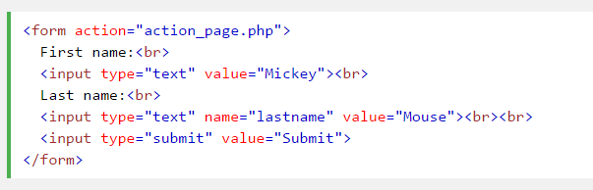
The <form> Element
The Name Attribute
Each input field must have a name attribute to be submitted.
If the name attribute is omitted, the data of that input field will not be sent at all.
This example will only submit the "Last name" input field:

Slide 27
Quiz
What is the difference between the anchor tag and the submit of a form?
Notes:
Anchor tag takes us to another page/place without taking data along while the form submit submits data to the specified action page

Slide 28
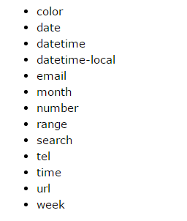
HTML5 Input Types
The input of type number defines a numeric input field and can have the following attributes: min, max , step which defines the minimum, maximum number and the number of steps it generates when you make use of the arrow keys
The <input type="range"> defines a control for entering a number whose exact value is not important (like a slider control). Default range is 0 to 100. However, you can set restrictions on what numbers are accepted with the min, max, and step attributes
The type = url, email and the above restrictions automatically helps you validate the input field when submitting the form

Slide 29
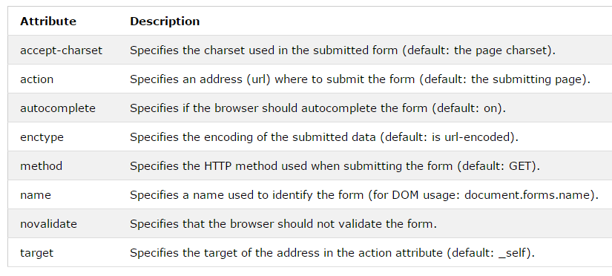
Other HTML Form Attributes

Slide 30
Assignment
Design a Contact Us Form, your form should capture the following elements:
Email Address, with the use of input type email
Names, with the use of input type text
Gender, with the use of input type radio
Home Address, with the use of textarea
Country, with the use of Select - Drop Down
Checkbox to indicate you want to get a feedback via phone call, Fax
Submit button
Reset Button

